Slide 1


Managing exam stress
www.kent.ac.uk/student-learning-advisory-service

Slide 2
How might stress affect you?
Susceptibility to illness (e.g. tummy aches)
Mood swings/emotional feelings
Nervous habits (e.g. biting fingernails)
Changes in eating and sleeping habits
Increase in smoking or drinking
Low energy, being unproductive
Not looking after yourself
You can do things to help avoid or reduce stress
You can also do things to help manage it

Slide 3
Avoid or reduce stress
Poor exam preparation may cause stress, so…
Start your revision early, get organised and work to a plan
Use effective revision skills to be confident that you are revising properly
Familiarise yourself with exam techniques (including any IT requirements) so you know that you will manage the exam well on the day
(See Online Bitesize Skills Development sessions and study guides on ‘Planning your revision’, Revision skills’ and exam techniques’)
Available at: http://www.kent.ac.uk/student-learning-advisory-service

Slide 4
Avoid or reduce stress
Fear of the unknown may cause stress, so…
Find out when, where and how each exam will take place
Find out the rules and IT requirements for online exams
Develop a good idea of the topics likely to come up, based on studying past exam papers, topics emphasised by lecturers or related to key module/learning outcomes
Use past papers to familiarise yourself with exam formats and typical content. Practise sitting them in exam conditions
(See Online Bitesize Skills Development sessions on ‘Online exams’, and the SLAS study guide ‘Planning Revision and Preparation for Online Exams’)
Available at: http://www.kent.ac.uk/student-learning-advisory-service

Slide 5
Avoid or reduce stress
Unexpected problems may cause stress, so…
Think ahead and adopt a ‘just in case’ policy
- The day before an online exam check that your IT is working
- Make a ‘do not disturb’ sign for your door to avoid interruptions
- If travelling, catch an earlier bus than you need, ‘just in case’.
- If you are unfamiliar with the room in which the exam will
take place, check its location before the day of the exam
- Have contingency plans in place to cope with unforeseen caring
or work situations that might arise before or during your exam.

Slide 6
On exam day
Avoid large amounts of caffeine/sugar (and any resulting crash)
Eat - preferably a balanced breakfast/lunch.
Arrive at exam hall, or your ‘workstation’, in plenty of time
Check you are in the right place, sitting the right exam
Get comfortable, relax and breathe
Don’t rush – think and plan before you start writing
- Read the information carefully and follow all instructions
- Work out a time plan (and stick to it)
- Decide on your strategy (e.g. high/easy points questions first)
- Now you can start confidently

Slide 7
During the exam
Stay aware of timing throughout – stick to your plan
If things go wrong don’t panic, use these recovery strategies…
If your mind goes blank… | Put pen down, read what you’ve done so far, plan next steps
 | Note everything you know about the topic
 | Leave a gap and move to next question. Go back later
If you are running out of time… | Divide remaining time between number of answers – better to put key information in each rather than leave any blank if you can help it
 | Get main points down and any evidence, even if it is just in bullets. Go back later to fill in detail if you have time
If you are getting confused… | Stop writing and re-read the question
 | Re-look at your plan – have you gone off track?

Slide 8
Summary - final tips
To avoid, reduce and manage exam stress:
Prepare well - start early, get organised, revise efficiently
Eliminate the unknown - find out what you need to know
Work to a plan - for revision, exam papers, individual essays
Take regular breaks during revision
Look after your health (eat well, get enough sleep, exercise)

Slide 9
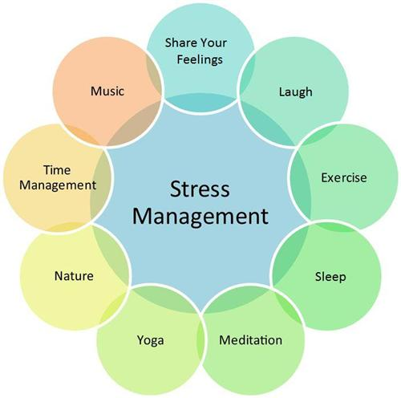
Choose and use…
All of these activities may help you manage exam stress:
‘Brainsmart’ (BBC) https://www.youtube.com/watch?v=hnpQrMqDoqE

Slide 10
Help and information
For up-to-date exam information go to:
https://www.kent.ac.uk/csao/exams/students/index.html
Mindfulness techniques - Guides and tutorials help you relax: https://www.kent.ac.uk/guides/mindfulness
Seeking further support - Student Support and Wellbeing: https://www.kent.ac.uk/student-support

Slide 11
Further resources
For guidance on the broader range of revision and exam skills please go to the SLAS webpages http://www.kent.ac.uk/student-learning-advisory-service where you can:
Book a one-to-one appointment with a SLAS adviser
Attend a range of Online Bitesize Skills Development sessions which include topics such as ‘Revision skills’, ‘Exam techniques’ and ‘Online exams’.

Slide 12
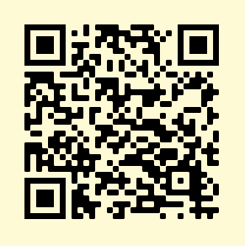
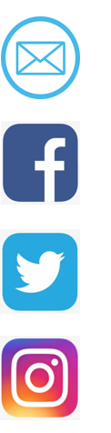
Get in touch…
SLAS
CONNECT
To book an appointment:
www.kent.ac.uk/student-learning-advisory-service
learning@kent.ac.uk
SLASkent
KentUniSLAS
SLASkent

