Slide 1



Managing your essay
www.kent.ac.uk/student-learning-advisory-service
Notes:
Managing your essay

Slide 2
Managing your essay
By the end of this tutorial you will:
Understand the stages of work involved
Know how much time to allocate for each stage
Be able to create a schedule to stay on track
Notes:
As with any project, you need to ensure that your essay is completed on time and to the best of your ability.
By the end of this tutorial you will:
Z Understand the stages of work involved in the production of a university essay
Z Know how to allocate appropriate time for each of these stages and…
Z Be able to create a schedule which will help you manage the work involved

Slide 3
Stages of work
There are four main stages:
Considering the question
Researching
Writing and revision
Checking
Notes:
The production of an essay can be broken into four main stages.
Z Considering the question
Z Research
Z Writing and revision, and
Z Checking

Slide 4
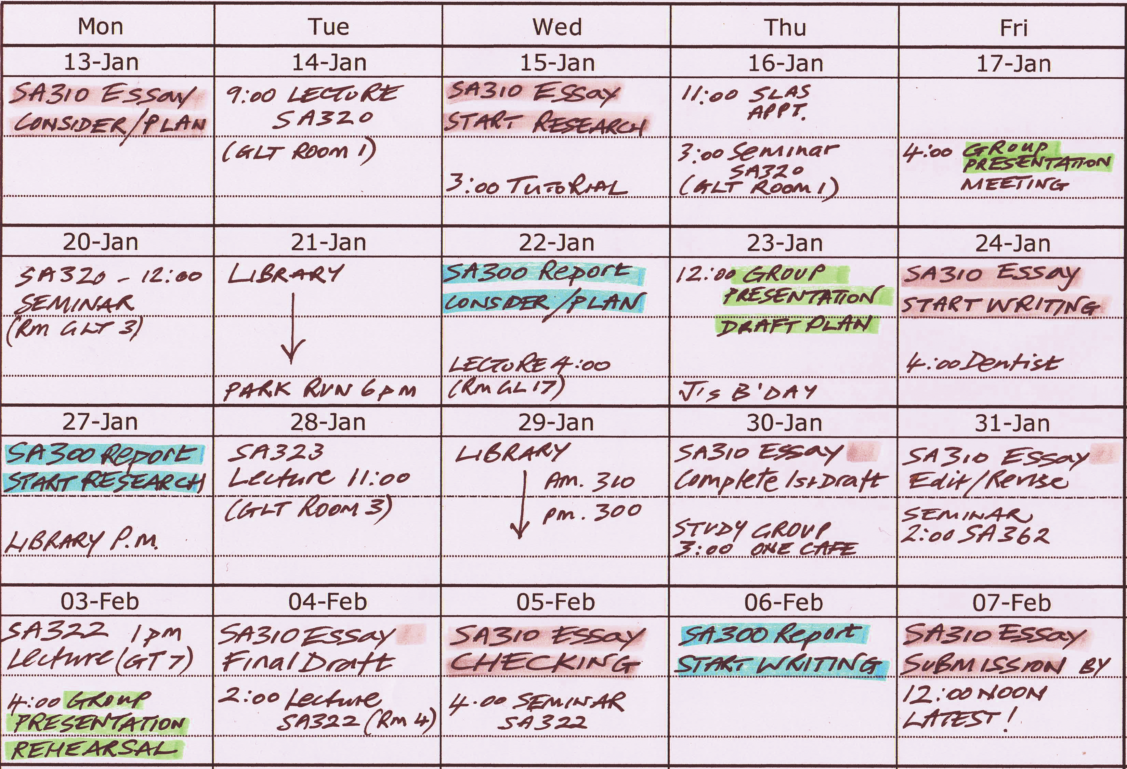
Stages of work
Notes:
You will need to allocate time for each of these stages of work, perhaps plotted on a term or year planner or digital equivalent, so that you can see clearly what you need to do, and by when. In doing so you will need to take account of any other personal or academic commitments competing for your time. If you are working on several assignments over the same period it may help to use colour coding or some other system to distinguish between them.
Let’s look at the four stages in more detail and consider how much time you should devote to each one.

Slide 5
1. Considering the question (10%)
Understanding
Avenues of research
Preliminary essay plan
Notes:
Firstly, allow time at the outset to Z consider the question and Z the avenues of research that might be required to answer it. These you can turn into Z a preliminary essay plan, which sets out in a logical order the key issues you will be investigating, and about which you will be writing.
You might allocate up to 10% of your time for this stage, perhaps the equivalent of a couple of days on a month-long assignment.
Careful consideration of the question at the outset will ensure that the work you carry out afterwards is based on a sound footing. Our tutorial ‘Understanding the question’ will describe how to do this, and other tutorials in this essay writing series will help you understand and develop the academic skills required for all the other stages of work.

Slide 6
2. Researching (40%)
Relevance, breadth and quality
Books, journals and other sources
Clear notes (including bibliographic details of each source)
Notes:
Once you have analysed the task ahead you are ready to commit time to your research.
Your essay will only be as good as the Z relevance, breadth and quality of the information you have gathered Z from books, journals and other sources. So, leave enough time to read and Z make clear notes around all the key aspects of the question from the most reliable and up-to-date scholarly sources available. Take care to record the bibliographic details of your sources as you go along - you will need these when you come to write your essay. Your research provides the jigsaw pieces from which you will construct your essay, so make sure you have collected all you need.
Perhaps around 40% of your time should be allocated to this stage.

Slide 7
3. Writing and revision (40%)
First draft
Ongoing editing and revision as you improve:
- Structure
- Content
- Clarity
Notes:
Writing is the next stage, for which another 40% of your time should be allocated.
Some students may write an essay the night before the deadline, but writing an excellent essay involves an ongoing process of constant revision and improvement, which takes time. Before you start you may need to update your preliminary essay plan to reflect additional points or arguments uncovered by your research. With this done, you are ready to write Z your first draft, which should comprise an introduction, main body paragraphs and a conclusion. Z What follows is a process of constant revision and redrafting as you strive to improve the Z structure, Z content and Z clarity of your work until you feel happy with it.
Note, that you may choose to write your main body paragraphs first, as they contain the key points of your argument.

Slide 8
4. Check (10%)
Academic language
Spelling
Grammar
Punctuation
Tenses
Referencing
Notes:
Even though you may have been constantly revising your work during the writing stage, you must always allow time to check your work thoroughly before handing it in - perhaps, again 10% of your overall schedule. To do justice to all your hard work you need to ensure that your arguments are clearly expressed, and that the essay is error free. Several proof-checking ‘sweeps’ may be necessary to ensure that the Z academic language, Z spelling, Z grammar, Z punctuation, Z tenses and Z referencing are all correct.

Slide 9
Your time plan - summary
Considering the question (10%)
Research (40%)
Write (40%)
Check (10%)
Notes:
All of these stages are vital. Whilst the proportion of time you allocate to each may vary slightly from those shown (depending, for example, on whether you have two weeks or two months to complete an essay) drawing up a realistic time schedule before you begin work will ensure that none of them is neglected.
Doing this for all your essays will enable you to juggle several assignments at once.

Slide 10
Further resources
Assignment Survival Kit (ASK)
https://www.kent.ac.uk/ai/ask/
Term planner
http://www.kent.ac.uk/student-learning-advisory-service
Notes:
To help you create a schedule for your essay you might try the Z Assignment Survival Kit (ASK) – the University of Kent’s online essay planning tool – or download and print a Z University of Kent term planner. Both can be accessed via the links shown.
Z On our webpages at www.kent.ac.uk/learning you will find the rest of this essay writing tutorial series, which covers all the main academic skills required to complete your essay, alongside a range of more detailed study guides covering these topics and more. There is also an easy-to-follow booking system allowing you to book a one-to-one session with one of our advisers.

Slide 11
Managing your essay
You should now be able to:
Understand the stages of work involved
Create a schedule to stay on track
Undertake them efficiently
If there’s anything you don’t understand please book an appointment, or contact us at learning@kent.ac.uk
Notes:
So, we’ve outlined the importance of managing your essays from start to finish. You should now have Z a good understanding of the different stages of work involved, and how to Z create a schedule that allows you to Z undertake them efficiently to complete your essay successfully and on time.

Slide 12
Get in touch…
The Student Learning Advisory Service is committed to continually improving the quality of service we offer to our students.
Your feedback is very important to us.
Please contact us at learning@kent.ac.uk
Notes:
If you have any feedback on this tutorial or any of our services please let us know. In the meantime, good luck with your essays and remember, it pays to plan ahead.

Slide 13
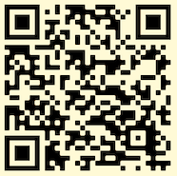

Get in touch…
SLAS
CONNECT
To book an appointment:
www.kent.ac.uk/student-learning-advisory-service
learning@kent.ac.uk
SLASkent
KentUniSLAS
SLASkent

